Slide 1

Hypothesis testing
ML LABS PVT LTD || WWW.ANALYTICS6.COM || DATA SCIENCE , AI , ML ,COMPUTER VISION || TRAINING AND CONSULTING
Phone Number : 91-6362546088 || Email : contact@analytics6.com

Slide 2
What is hypothesis testing?
A hypothesis is an assumption about the population parameter.
A parameter is characteristic of the population , like its mean or variance.
The parameter must be identified before analysis.
ML LABS PVT LTD || WWW.ANALYTICS6.COM || DATA SCIENCE , AI , ML ,COMPUTER VISION || TRAINING AND CONSULTING
Phone Number : 91-6362546088 || Email : contact@analytics6.com

Slide 3
Types of statistical hypotheses:
There are two types of statistical hypotheses.
Null hypothesis. The null hypothesis, denoted by Ho, is usually the hypothesis that sample observations result purely from chance.
Alternative hypothesis. The alternative hypothesis, denoted by H1 or Ha, is the hypothesis that sample observations are influenced by some non-random cause.
ML LABS PVT LTD || WWW.ANALYTICS6.COM || DATA SCIENCE , AI , ML ,COMPUTER VISION || TRAINING AND CONSULTING
Phone Number : 91-6362546088 || Email : contact@analytics6.com

Slide 4
Formula:
The two important parts here are the null hypothesis and the alternative hypothesis. The formula to measure the null hypothesis and the alternate hypothesis involves the null hypothesis and the alternative hypothesis.
H0:µ0=0
Ha: µ0≠0
Where
H0 = null hypothesis
Ha = alternate hypothesis
ML LABS PVT LTD || WWW.ANALYTICS6.COM || DATA SCIENCE , AI , ML ,COMPUTER VISION || TRAINING AND CONSULTING
Phone Number : 91-6362546088 || Email : contact@analytics6.com

Slide 5
Testing of hypothesis works
A hypothesis is an assumption about the population parameter which is to be tested.
In hypothesis testing, an analyst tests a statistical sample , with the goal of providing evidence on the plausibility of the null hypothesis.
ML LABS PVT LTD || WWW.ANALYTICS6.COM || DATA SCIENCE , AI , ML ,COMPUTER VISION || TRAINING AND CONSULTING
Phone Number : 91-6362546088 || Email : contact@analytics6.com

Slide 6
Testing of hypothesis works
Statistical analysts test a hypothesis by measuring and examining a random sample of the population being analyzed.
All analysts use a random population sample to test two different hypotheses: the null hypothesis and the alternative hypothesis.
ML LABS PVT LTD || WWW.ANALYTICS6.COM || DATA SCIENCE , AI , ML ,COMPUTER VISION || TRAINING AND CONSULTING
Phone Number : 91-6362546088 || Email : contact@analytics6.com

Slide 7
Steps of hypothesis testing:
All hypotheses are tested using a four-step process:
-The first step is for the analyst to state the two hypotheses so that only one can be right.
-The next step is to formulate an analysis plan, which outlines how the data will be evaluated.
ML LABS PVT LTD || WWW.ANALYTICS6.COM || DATA SCIENCE , AI , ML ,COMPUTER VISION || TRAINING AND CONSULTING
Phone Number : 91-6362546088 || Email : contact@analytics6.com

Slide 8
Steps of hypothesis testing
-The third step is to carry out the plan and physically analyze the sample data.
-The fourth and final step is to analyze the results and either reject the null hypothesis, or state that the null hypothesis is plausible, given the data.
ML LABS PVT LTD || WWW.ANALYTICS6.COM || DATA SCIENCE , AI , ML ,COMPUTER VISION || TRAINING AND CONSULTING
Phone Number : 91-6362546088 || Email : contact@analytics6.com

Slide 9
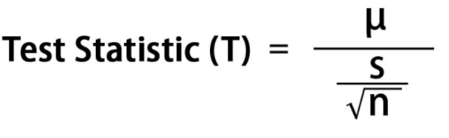
Hypothesis testing formula
It has two parts: the null hypothesis and the other is known as the alternative hypothesis. The null hypothesis is the one that the researcher tries to reject. It isn’t easy to prove the alternate hypothesis, so if the null hypothesis is rejected, the remaining alternate theory gets accepted. It is tested at a different level of significance will the help of calculating the test statistics.
ML LABS PVT LTD || WWW.ANALYTICS6.COM || DATA SCIENCE , AI , ML ,COMPUTER VISION || TRAINING AND CONSULTING
Phone Number : 91-6362546088 || Email : contact@analytics6.com

Slide 10
Significance level:
When we take 5% level of significance (α =.05),then there are about 5 chances out of 100 that we would reject the null hypothesis. In other words out of 100, 95% chances are there that the null hypothesis will be accepted
i.e. we are about 95% confidence that we have made the right decision.
ML LABS PVT LTD || WWW.ANALYTICS6.COM || DATA SCIENCE , AI , ML ,COMPUTER VISION || TRAINING AND CONSULTING
Phone Number : 91-6362546088 || Email : contact@analytics6.com

Slide 11
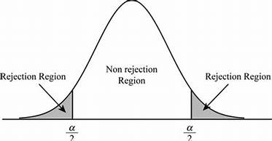
Selecting a significance level:
ML LABS PVT LTD || WWW.ANALYTICS6.COM || DATA SCIENCE , AI , ML ,COMPUTER VISION || TRAINING AND CONSULTING
Phone Number : 91-6362546088 || Email : contact@analytics6.com

Slide 12
Type 1 and Type 2 errors:
There are four possible results:
The hypothesis is true but our test accepts it.
The hypothesis is false but our test rejects it.
The hypothesis is true but our test rejects it.
The hypothesis is false but our test accepts it.
The last 2 possibilities lead to errors.
ML LABS PVT LTD || WWW.ANALYTICS6.COM || DATA SCIENCE , AI , ML ,COMPUTER VISION || TRAINING AND CONSULTING
Phone Number : 91-6362546088 || Email : contact@analytics6.com

Slide 13
Type 1 and Type 2 errors:
Rejecting a null hypothesis when it is true is called a Type 1 error.
Accepting a null hypothesis when it is false is called Type 2 error.
ML LABS PVT LTD || WWW.ANALYTICS6.COM || DATA SCIENCE , AI , ML ,COMPUTER VISION || TRAINING AND CONSULTING
Phone Number : 91-6362546088 || Email : contact@analytics6.com

Slide 14
One- tailed hypothesis tests:
One-tailed hypothesis tests are also known as directional and one-sided tests because you can test for effects in only one direction. When you perform a one-tailed test, the entire significance level percentage goes into the extreme end of one tail of the distribution.
ML LABS PVT LTD || WWW.ANALYTICS6.COM || DATA SCIENCE , AI , ML ,COMPUTER VISION || TRAINING AND CONSULTING
Phone Number : 91-6362546088 || Email : contact@analytics6.com

Slide 15
Two- tailed hypothesis tests
Two-tailed hypothesis tests are also known as nondirectional and two-sided tests because you can test for effects in both directions. When you perform a two-tailed test, you split the significance level percentage between both tails of the distribution.
ML LABS PVT LTD || WWW.ANALYTICS6.COM || DATA SCIENCE , AI , ML ,COMPUTER VISION || TRAINING AND CONSULTING
Phone Number : 91-6362546088 || Email : contact@analytics6.com

Slide 16
Advantages of one-tailed hypothesis tests
One-tailed tests have more statistical power to detect an effect in one direction than a two-tailed test with the same design and significance level. One-tailed tests occur most frequently for studies where one of the following is true:
Effects can exist in only one direction.
Effects can exist in both directions but the researchers only care about an effect in one direction. There is no drawback to failing to detect an effect in the other direction. (Not recommended.)
ML LABS PVT LTD || WWW.ANALYTICS6.COM || DATA SCIENCE , AI , ML ,COMPUTER VISION || TRAINING AND CONSULTING
Phone Number : 91-6362546088 || Email : contact@analytics6.com

Slide 17
Disadvantages of one-tailed hypothesis tests
The disadvantage of one-tailed tests is that they have no statistical power to detect an effect in the other direction.

Slide 18
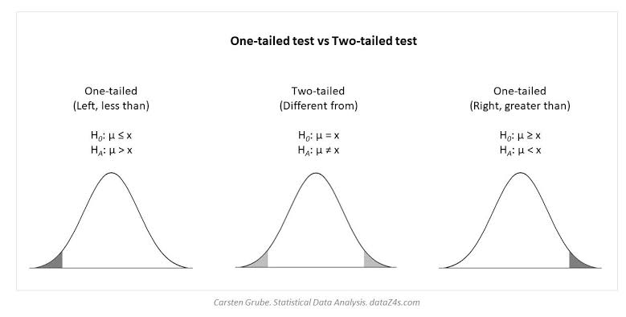
One tailed test and two tailed test
ML LABS PVT LTD || WWW.ANALYTICS6.COM || DATA SCIENCE , AI , ML ,COMPUTER VISION || TRAINING AND CONSULTING
Phone Number : 91-6362546088 || Email : contact@analytics6.com

